Slide 1
THE LIFE CYCLE OF A HEALTH EMERGENCY AND THE MARKET reaction
Andres mejia
Matthew Richards
Travis smith

Slide 2
agenda
introduction
Hypothesis discussion
General process
Data
Sources
Clean-up
Analysis
results
Conclusion
Recommendations
appendix

Slide 3
introduction HYPOTHESIS
In late 2019 the novel coronavirus was identified. In January of 2020 the world health organization (who) declared an international emergency. Within days the s&P 500 took a decline
Pundits offered that the decline was caused by news of the corona virus
We believe that global epidemics have a cycle and directly affect the stock market. we believe that this cycle can be understood through epidemiological statistics (summarized in news reports) and thus can predict volatility in the market and overall market movements.

Slide 4
Questions
Is there a cycle to global health emergencies?
are news articles correlated to movements in the market?
How Do health statistics affect news/ press releases?
can we develop a profitable trade strategy?

Slide 5
introduction process
Establish a broad timeline for diseases (start stop)
Pull s&P 500 (SPY) performance data across those time periods.
Quick visual check on repeated patterns
ESTABLISH BASE DATA FOR ANALYSES
Search for signal
check news dates for key events, plot those dates across the s&p 500 data
Calculate volatility of the spy, SPY SECTORS, GOLD ETF, TREASURIES ETF, in those date ranges TO DETERMINE IF THOSE EVENTS AFFECT MARKET CHANGES
Calculate rates of infection and deaths (summary statistics)
Calculate correlation between:
News and market fluctuations
Volatility and market fluctuations
Summary statistics and market fluctuations
Analyze results
Draw conclusions

Slide 6
DATA sources
Sars, ebola, zika, h1n1 DISEASE DATES (disease dates)
Cdc and who data
Pulled statistics from open source website, Kaggle. We were able to obtain datasets for zika, sars, and ebola
Datasets contained summary numbers of reported illnesses and deaths
H1n1 data was not found
Only reported zika illness data for united-states, due to the organization of the found dataset
World news data
Used new York times api to extract articles during disease dates
Filtered articles by who mention to isolate official reports
Stock data
Pulled data from GOOGLEFINANCE and Yahoo finance
SPY, SPY SECTORS, GOLD ETF, TREASURY ETF

Slide 7




DATA EXPLORATION AND CLEAN-UP
CDC AND WHO DATA
VIA KAGGLE OPEN SOURCE WEBSITE
ONLY FOUND ZIKA, SARS, EBOLA
PULLED CSV DATASETS INTO SQL VIA POSTGRES
PERFORMED SOME CLEAN-UP IN SQL/postgres
OTHER CLEAN-UP IN PYTHON/jupyterlab
FOR DEATH AND ILLNESS REPORTS:
value each reported time period (positional)
Change between each point (velocity)
Rate of change between each point (acceleration)

Slide 8
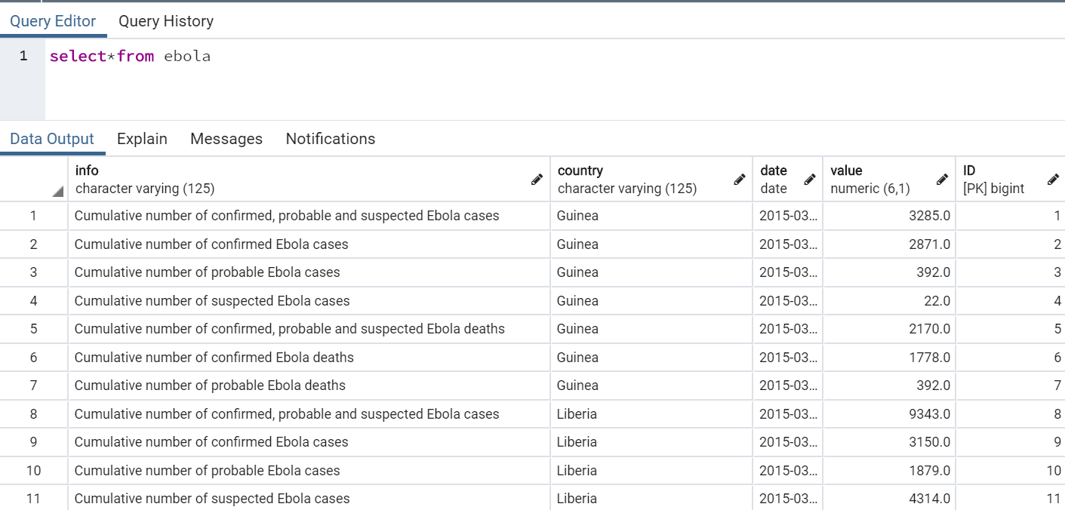
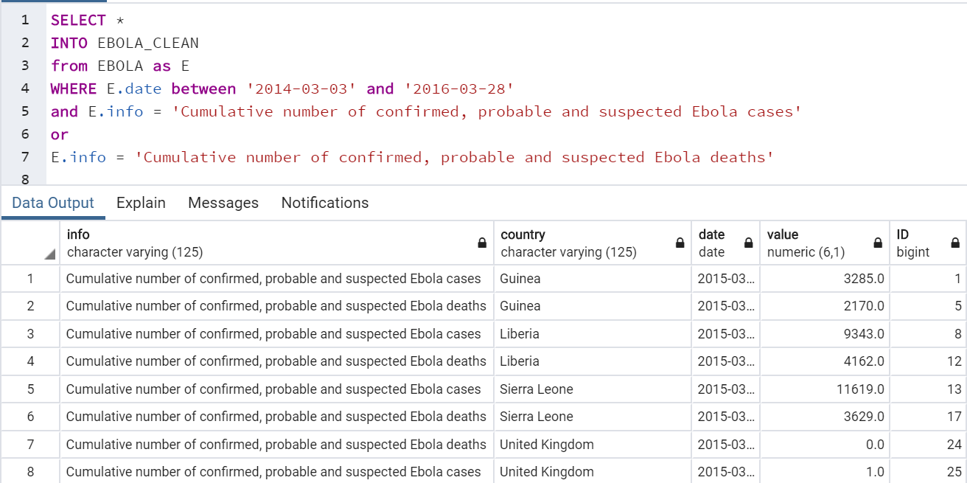
DATA EXPLORATION AND CLEAN-UP
EBOLA CLEAN UP IN SQL
SARS REQUIRED PARSING OF DATES
ZIKA CLEAN UP IN JUPYTER LAB

Slide 9
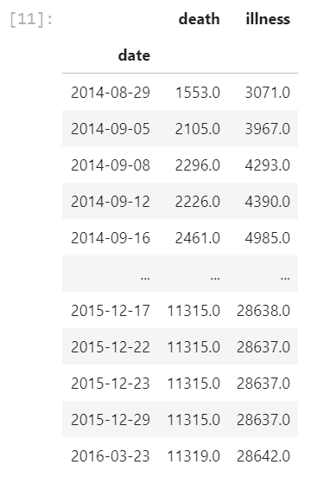
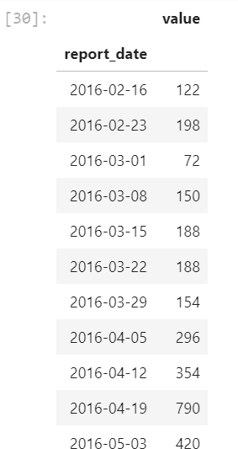
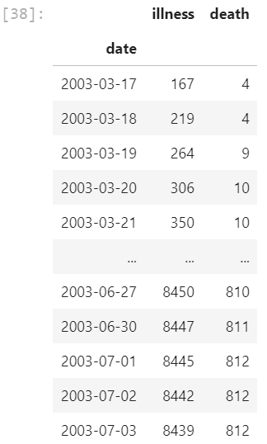
DATA EXPLORATION AND CLEAN-UP
EBOLA
ZIKA
SARS

Slide 10
Analysis characterization of summary statistics
Ebola and sars data came back as a cumulative report
Zika came back as a discrete instance
Searching for 4 factors:
Cumulative results (summation)
Discrete instances (positional information)
Changes in discrete instances over each report period (velocity information)
Rate-of-change (acceleration information)
Show code and charts

Slide 11

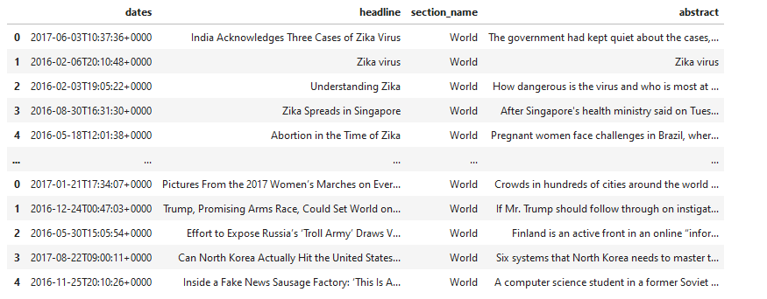
Analysis news data
EXPORT FROM API TO PANDAS DATAFRAME
FOR EACH DISEASE OVER 100 ARTICLES FOUND USING SEARCH CRITERA
AS EVIDENCED BY THE BOTTOM, NOT ALL ARTICLES WERE RELEVANT
FURTHER PARSED DATA BY SEARCHING FOR WHO
EXPORTED TO CSV

Slide 12
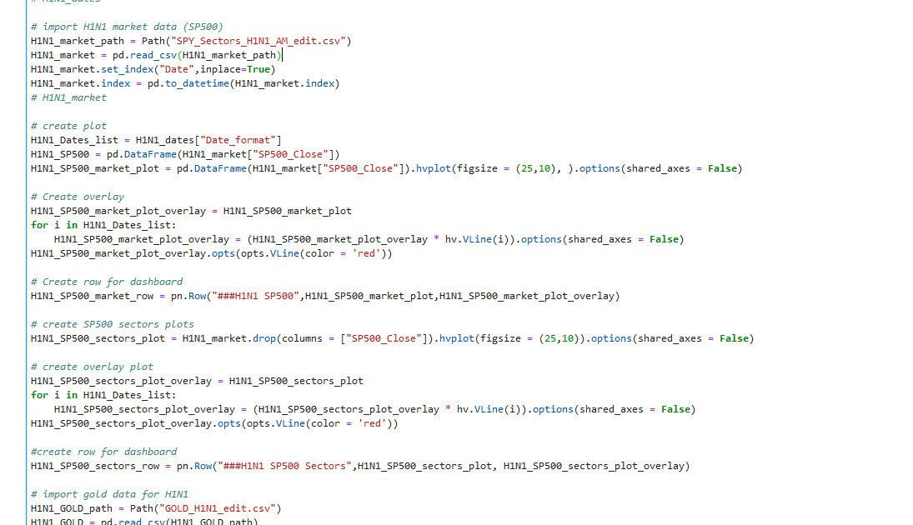
Analysis news data
CODE FOR EACH DISEASE
PULLED DATES FROM NYT CSV FILES
PULLED MARKET DATA FROM S&P 500
OVERLAYED NEWS DATES ON S&P 500 CHARTS

Slide 13
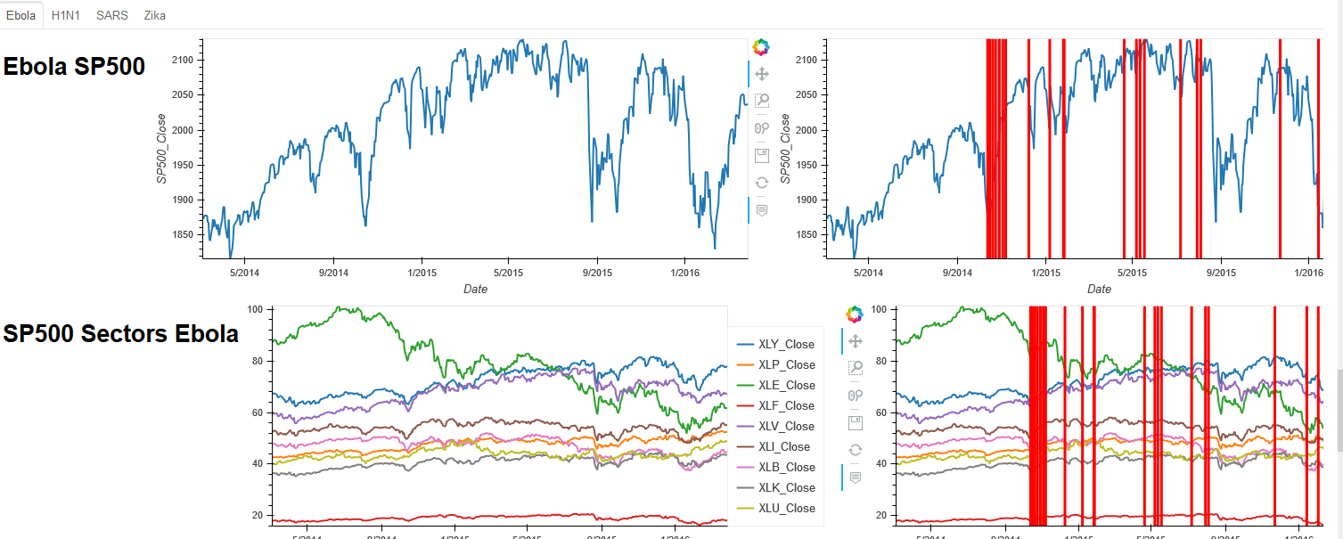
Analysis news data

Slide 14
Analysis news data
KEY DATES FOR DISEASES APPEARED TO COINCIDE WITH MOVEMENTS IN THE MARKETS; HOWEVER NOT ALL MOVEMENTS WITHIN THE MARKET WERE DETERMINED BY THESE EVENTS
While there appear to be a relationship between the news and movements in the market, more analysis/ verification is required in order to make a more definitive trade strategy

Slide 15
Analysis spy, spy sectors, gold etf, treasury etf
SPY ➔ S&P500 ETF
SPY Sectors ➔
GOLD ➔ Gold ETF
TLT ➔ T-Bonds ETF
Data from Google Finance and yahoo finance
Data organization and Clean up in pandas
Analysis and aggregation
visualizations
XLY: Consumer Discretionary | XLF: Financials | XLB: MAterials
XLP: Consumer Staples | XLV: Health Care | XLK: Technology
XLE: Energy | XLI: Industrials | XLU: Utilities

Slide 16
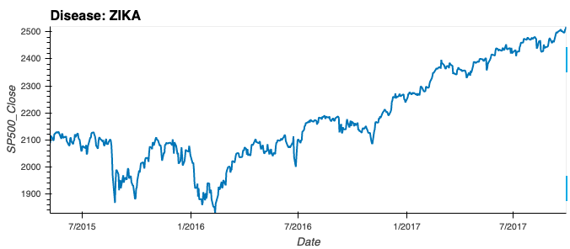
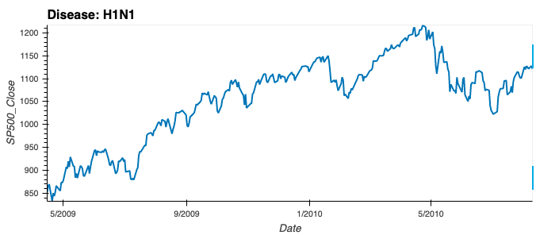
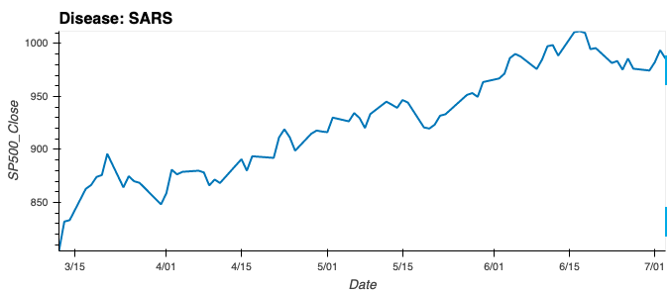
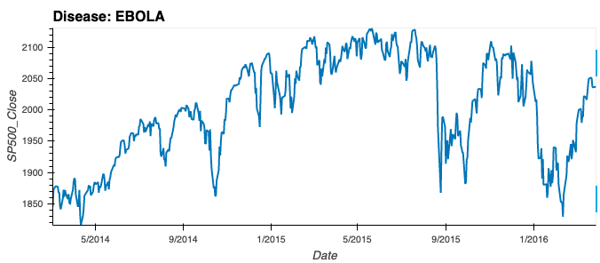
SPY (S&P500)

Slide 17
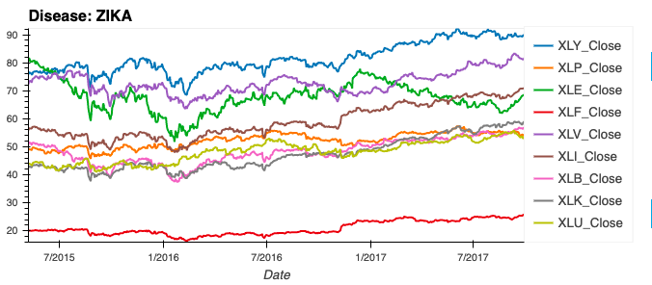
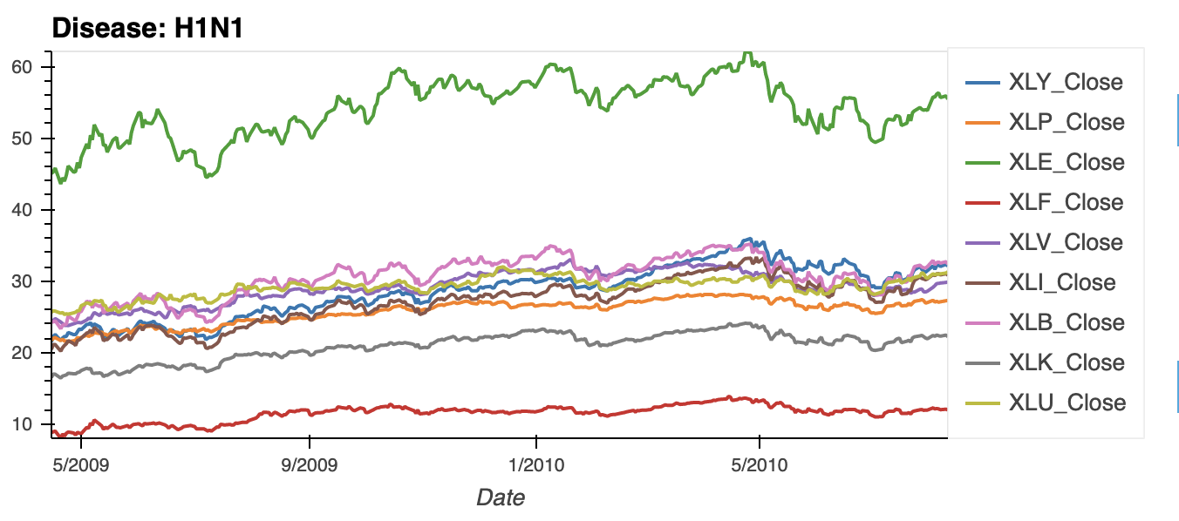
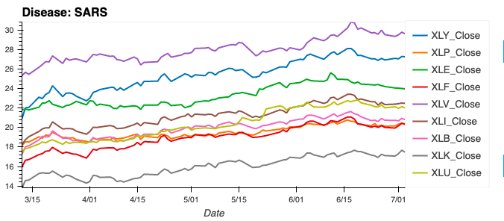
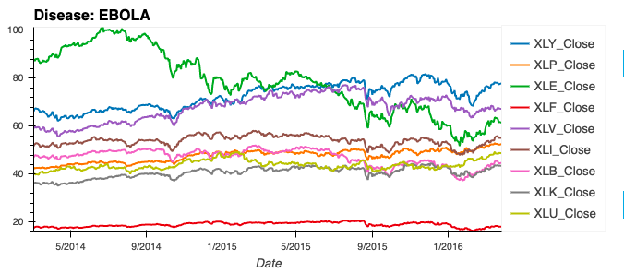
SPY_Sectors
XLY: Consumer Discretionary | XLF: Financials | XLB: MAterials
XLP: Consumer Staples | XLV: Health Care | XLK: Technology
XLE: Energy | XLI: Industrials | XLU: Utilities

Slide 18
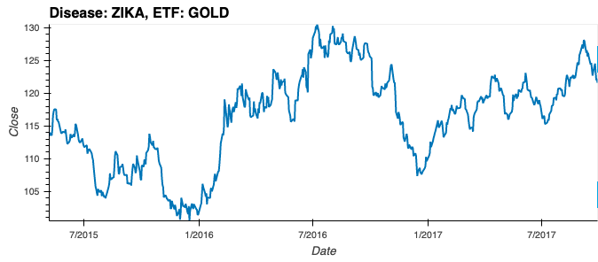
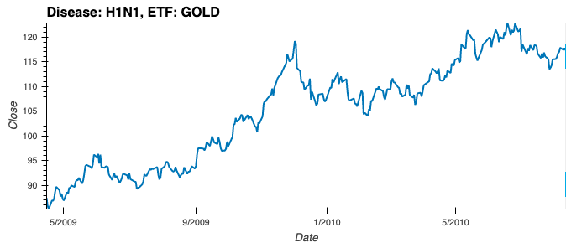
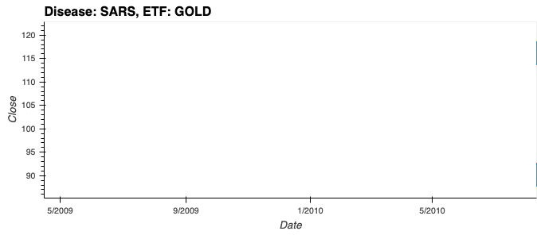
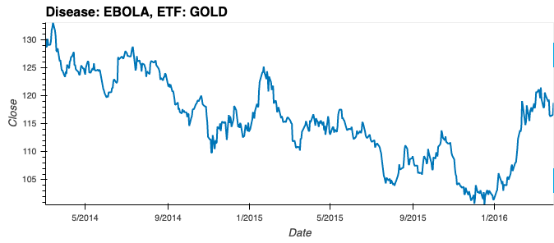
GOLD (Gold ETF)
No Data Found!

Slide 19
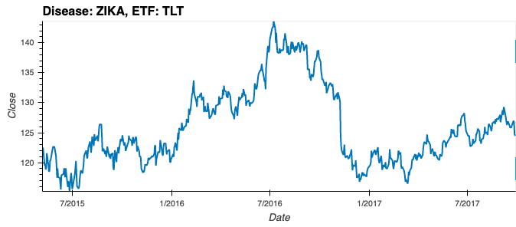
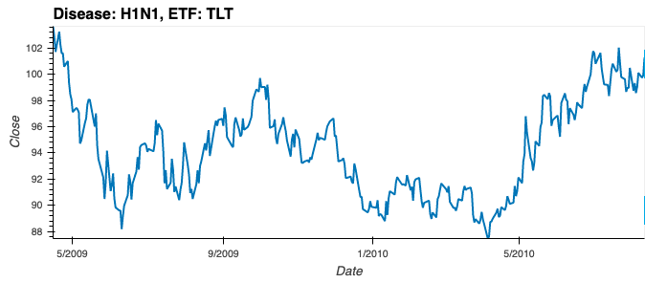
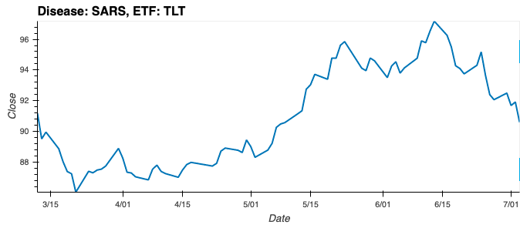
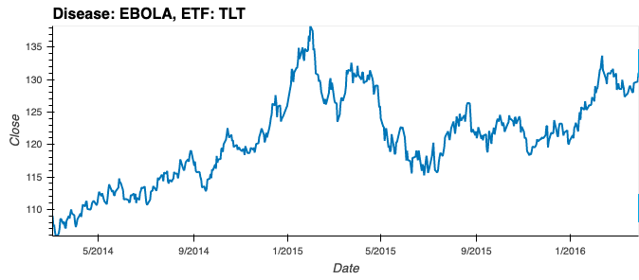
TLT (T-Bonds ETF)

Slide 20
Analysis volatility
Get the data in for GOLD, TLT and SPY Sectors in dataframes
Daily % Changes
Closing Price and Volume classified in High/Low according to daily movements
Indexes based on %Change, Close Price & Volume to identify:
H/l strength
Bu/Be Trend
Total volatility
visualization

Slide 21
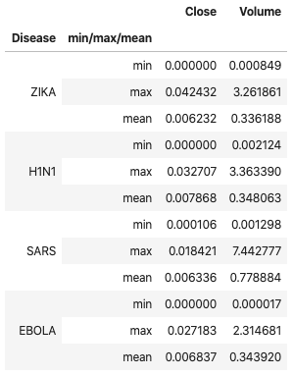
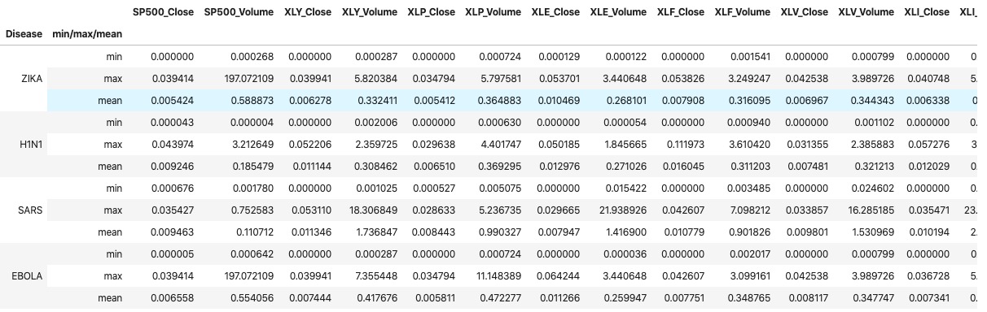
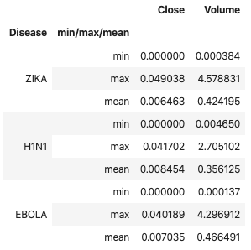
Volatility Index (Tailor Made – Step 1)
TLT Tranches
SPY/Sectors Tranches
GOLD Tranches

Slide 22
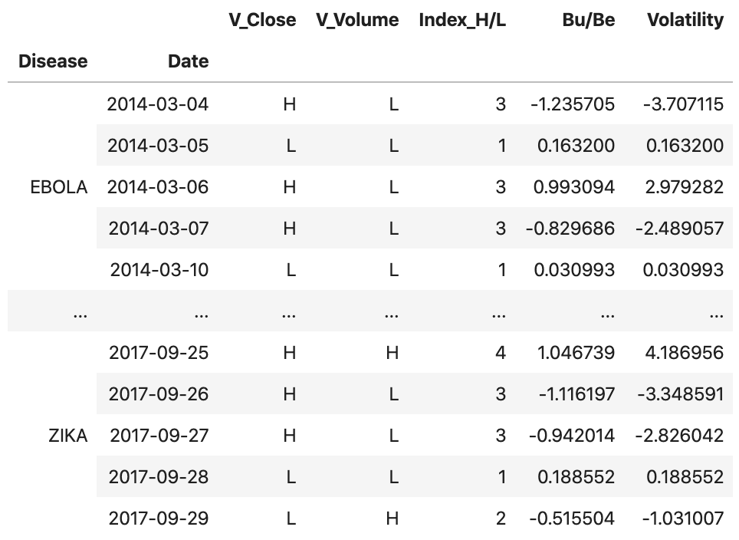
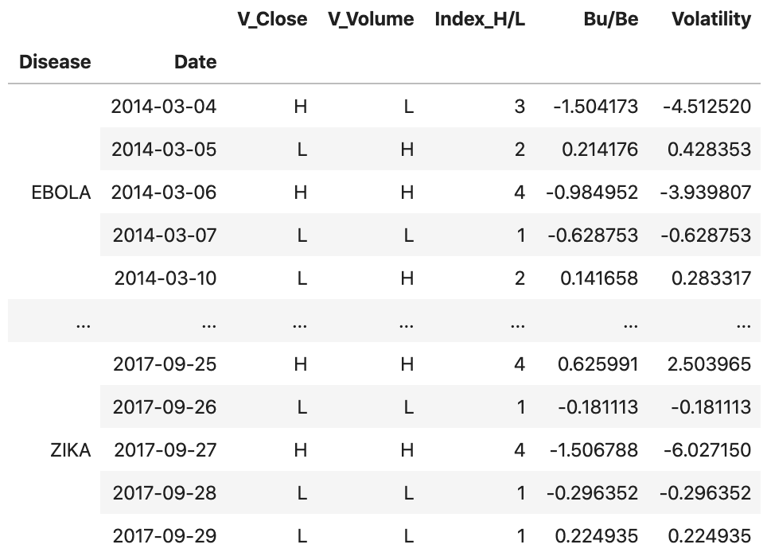
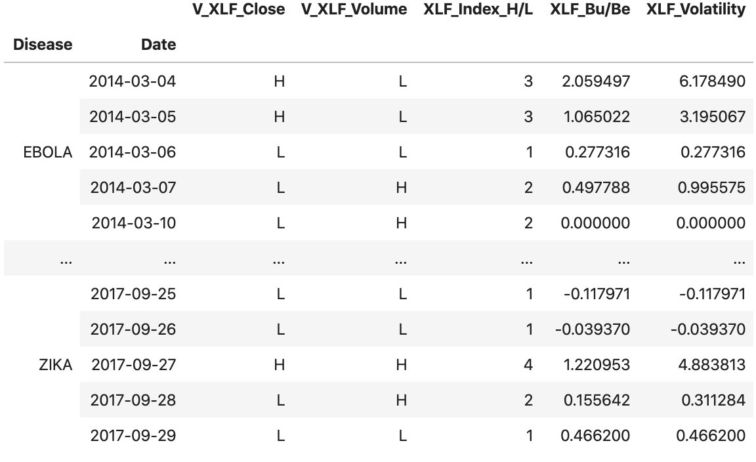
Volatility Index (Tailor Made – Step 2)
GOLD Volatility
TLT Volatility
SPY/Sectors Volatility
Indexes to identify Bu/Be Trends, based on %Change, Close Prices & Volumes

Slide 23
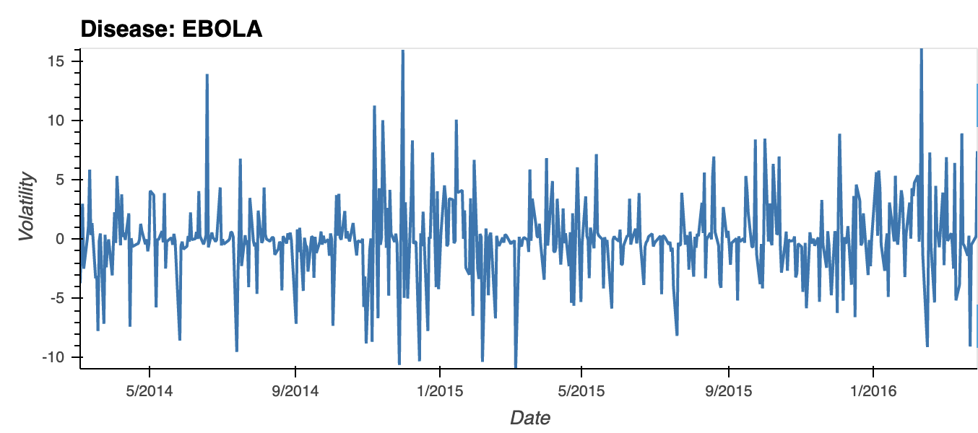
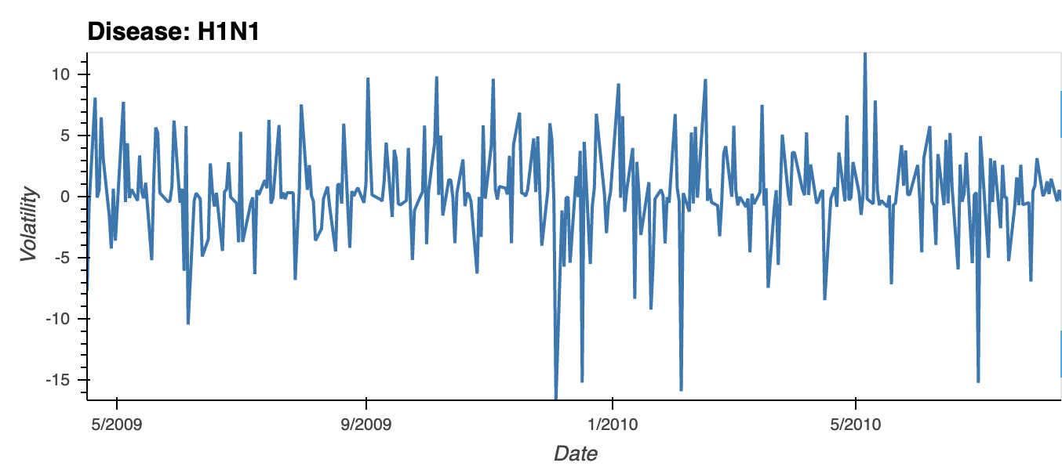
Volatility Index (Tailor Made – GOLD Visualization)

Slide 24
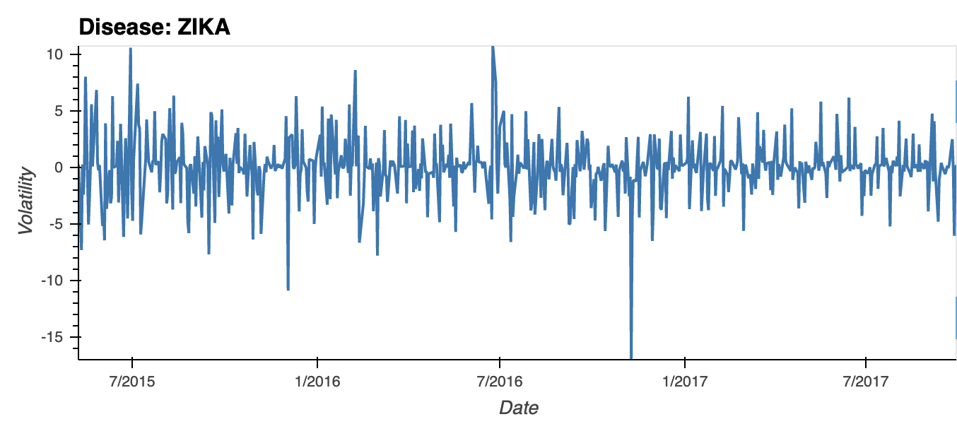
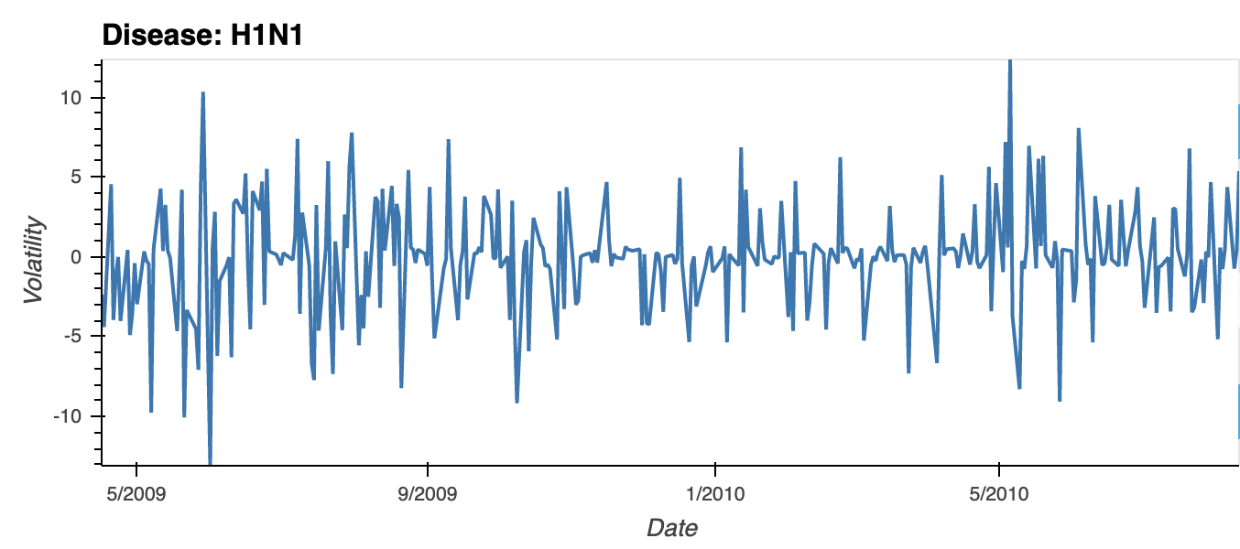
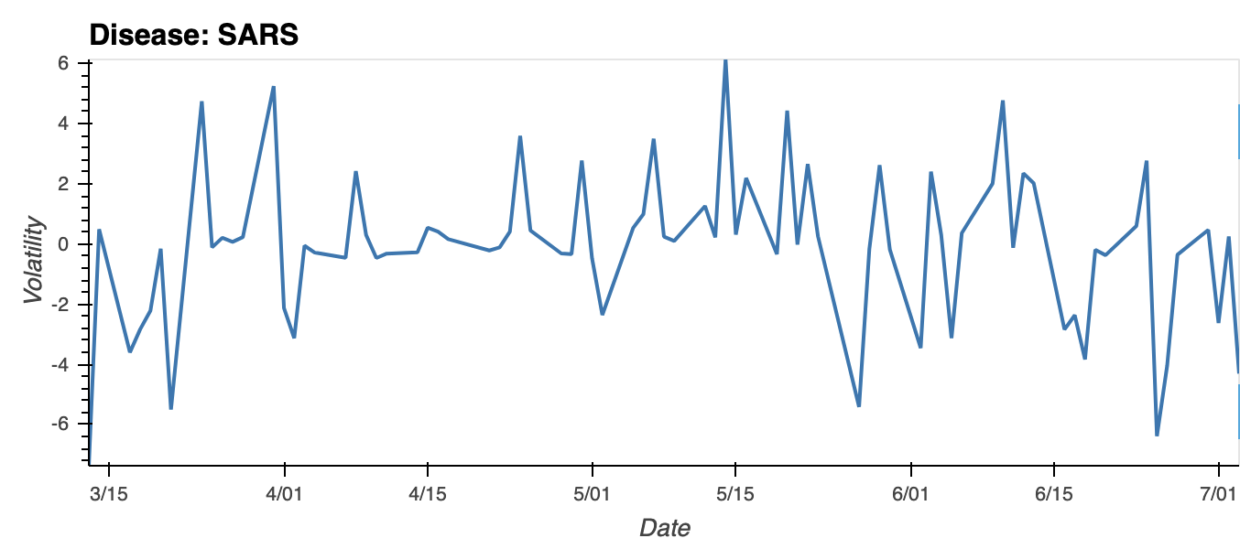
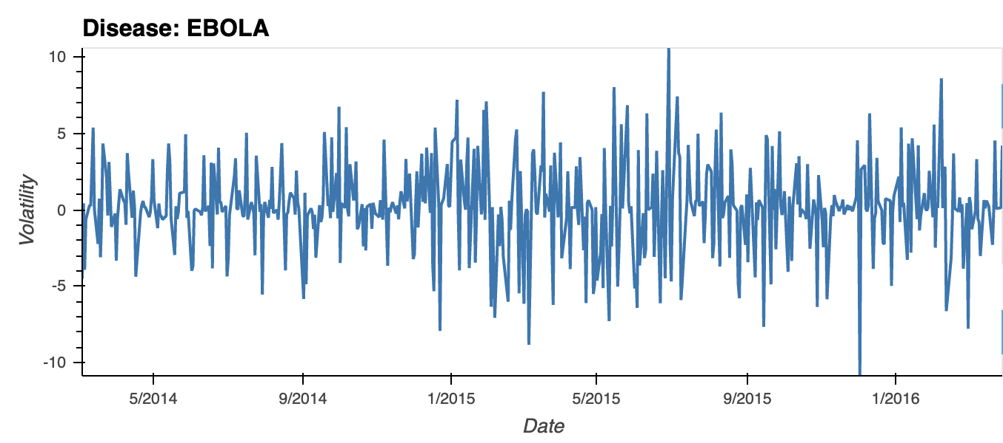
Volatility Index (Tailor Made – TLT Visualization)

Slide 25
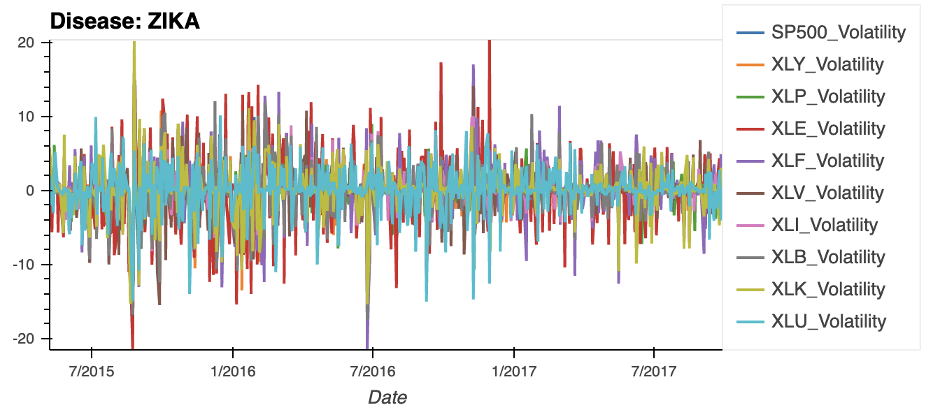
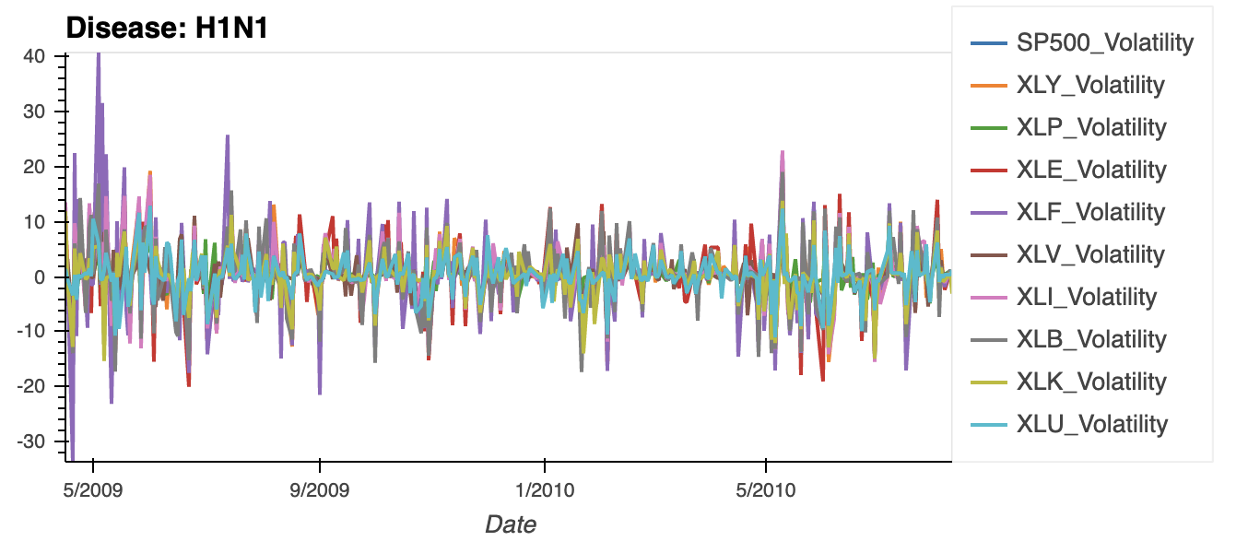
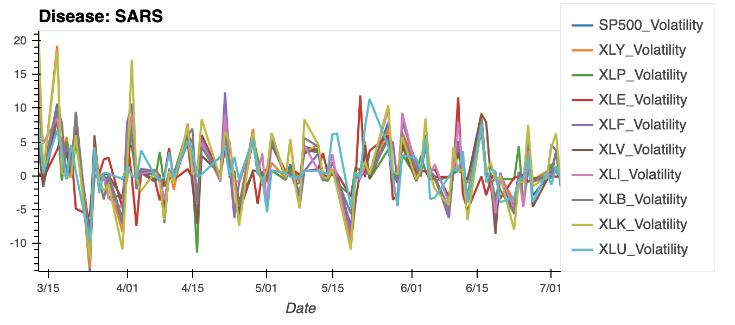
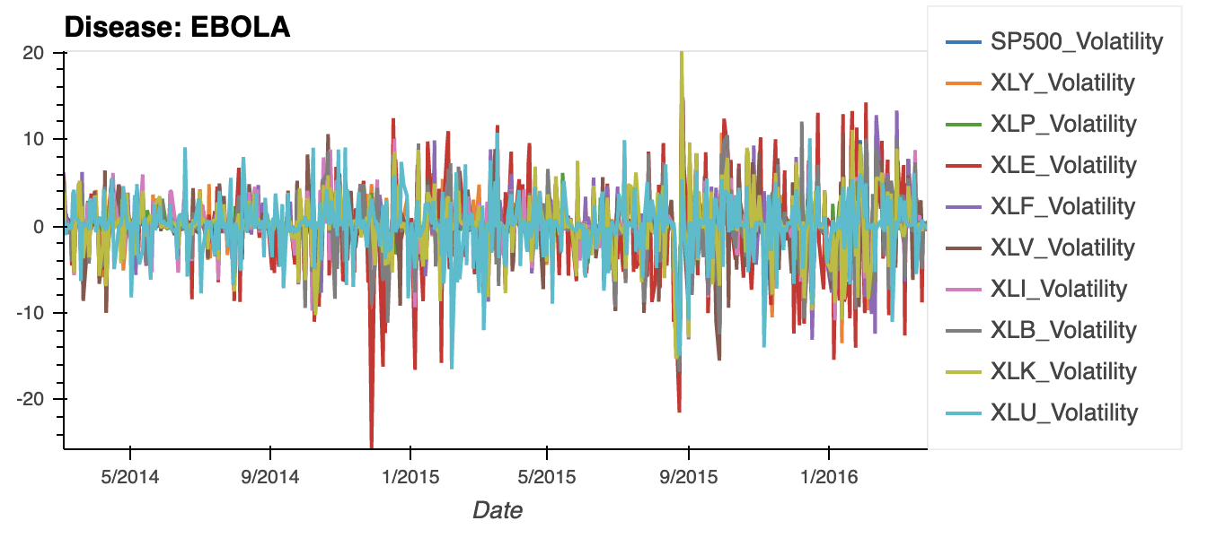
Volatility Index (Tailor Made – S&P500 Visualization)

Slide 26
Analysis correlation
ZIKA CUMULATIVE
ZIKA VELOCITY
SARS CUMULATIVE
SARS VELOCITY
EBOLA CUMULATIVE
EBOLA VELOCITY
NEWS

Slide 27
results

Slide 28
results summary statistics
Trends of each disease
Correlation To the market

Slide 29
results volatility
Create an index to identify volatility movements linked to:
Deseases
News
Illness
Deaths
SIGNALS identification
visualization

Slide 30
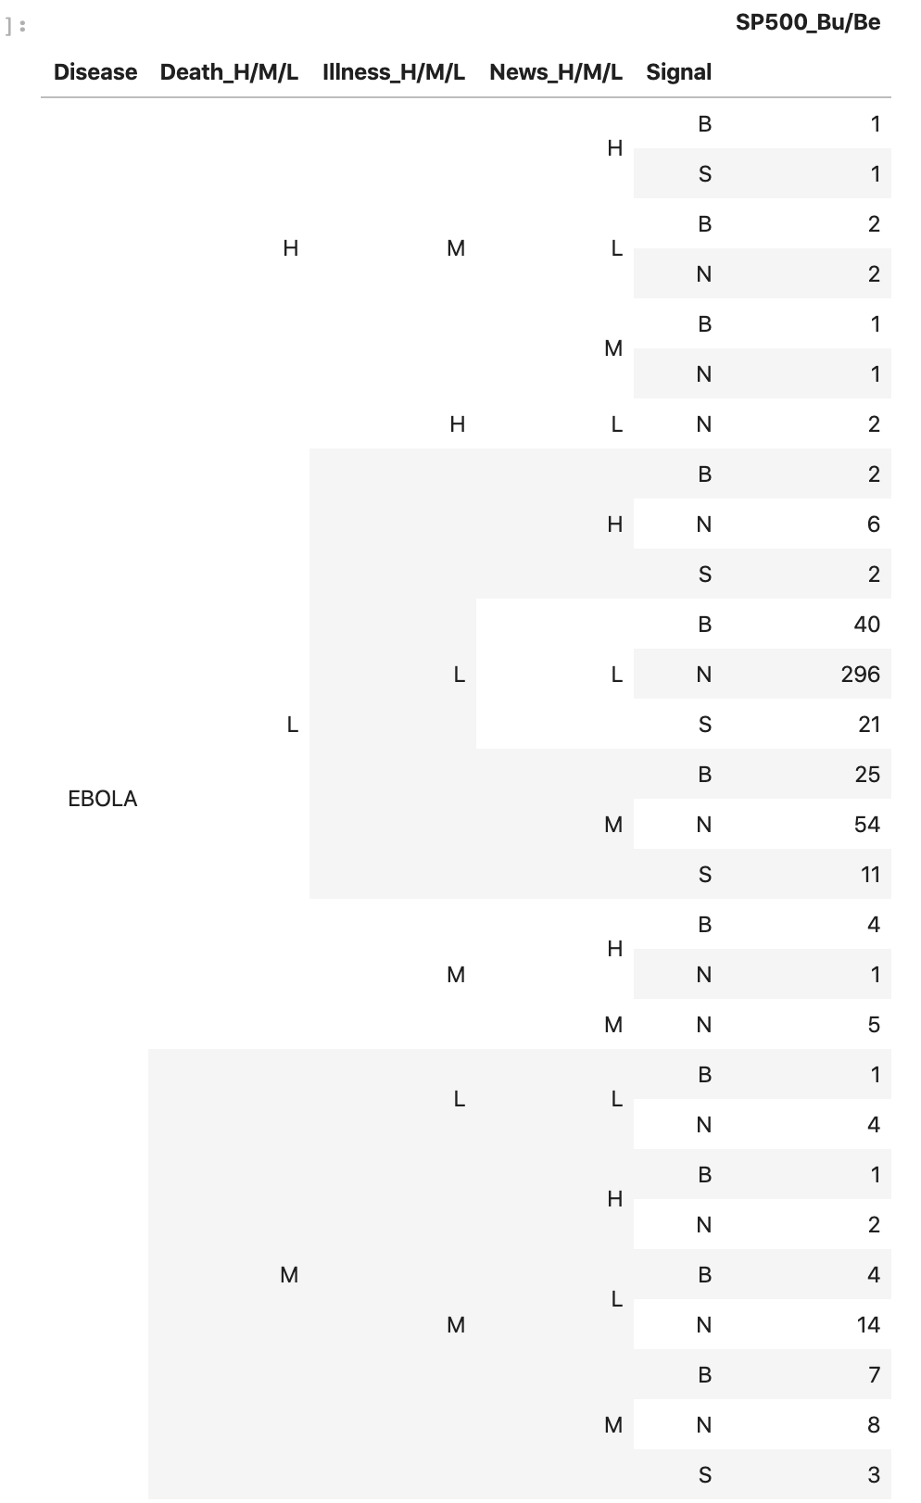
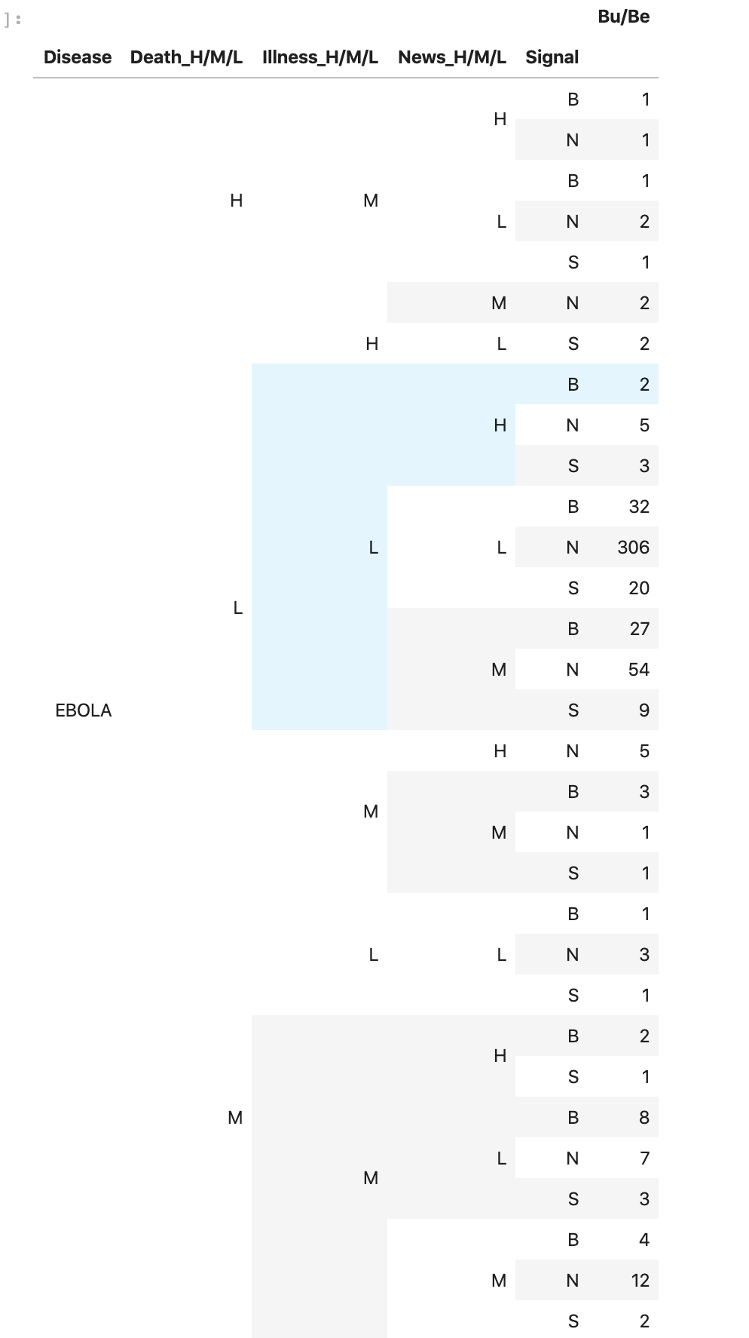
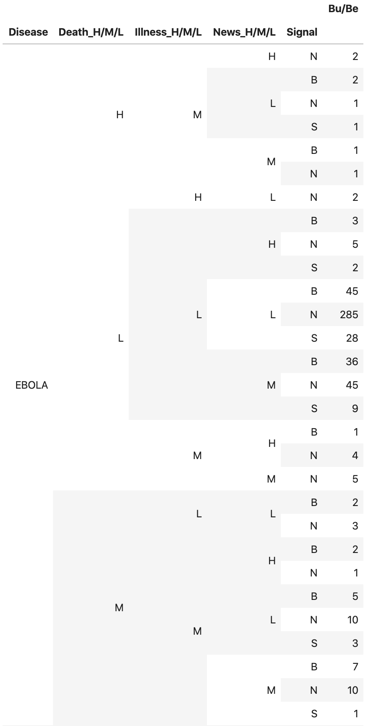
results volatility
SPY
GOLD
TLT
DESEASES - DEATHS/ILLNESS/NEWS → BUY/SELL SIGNALS (COUNT)

